Slide 1
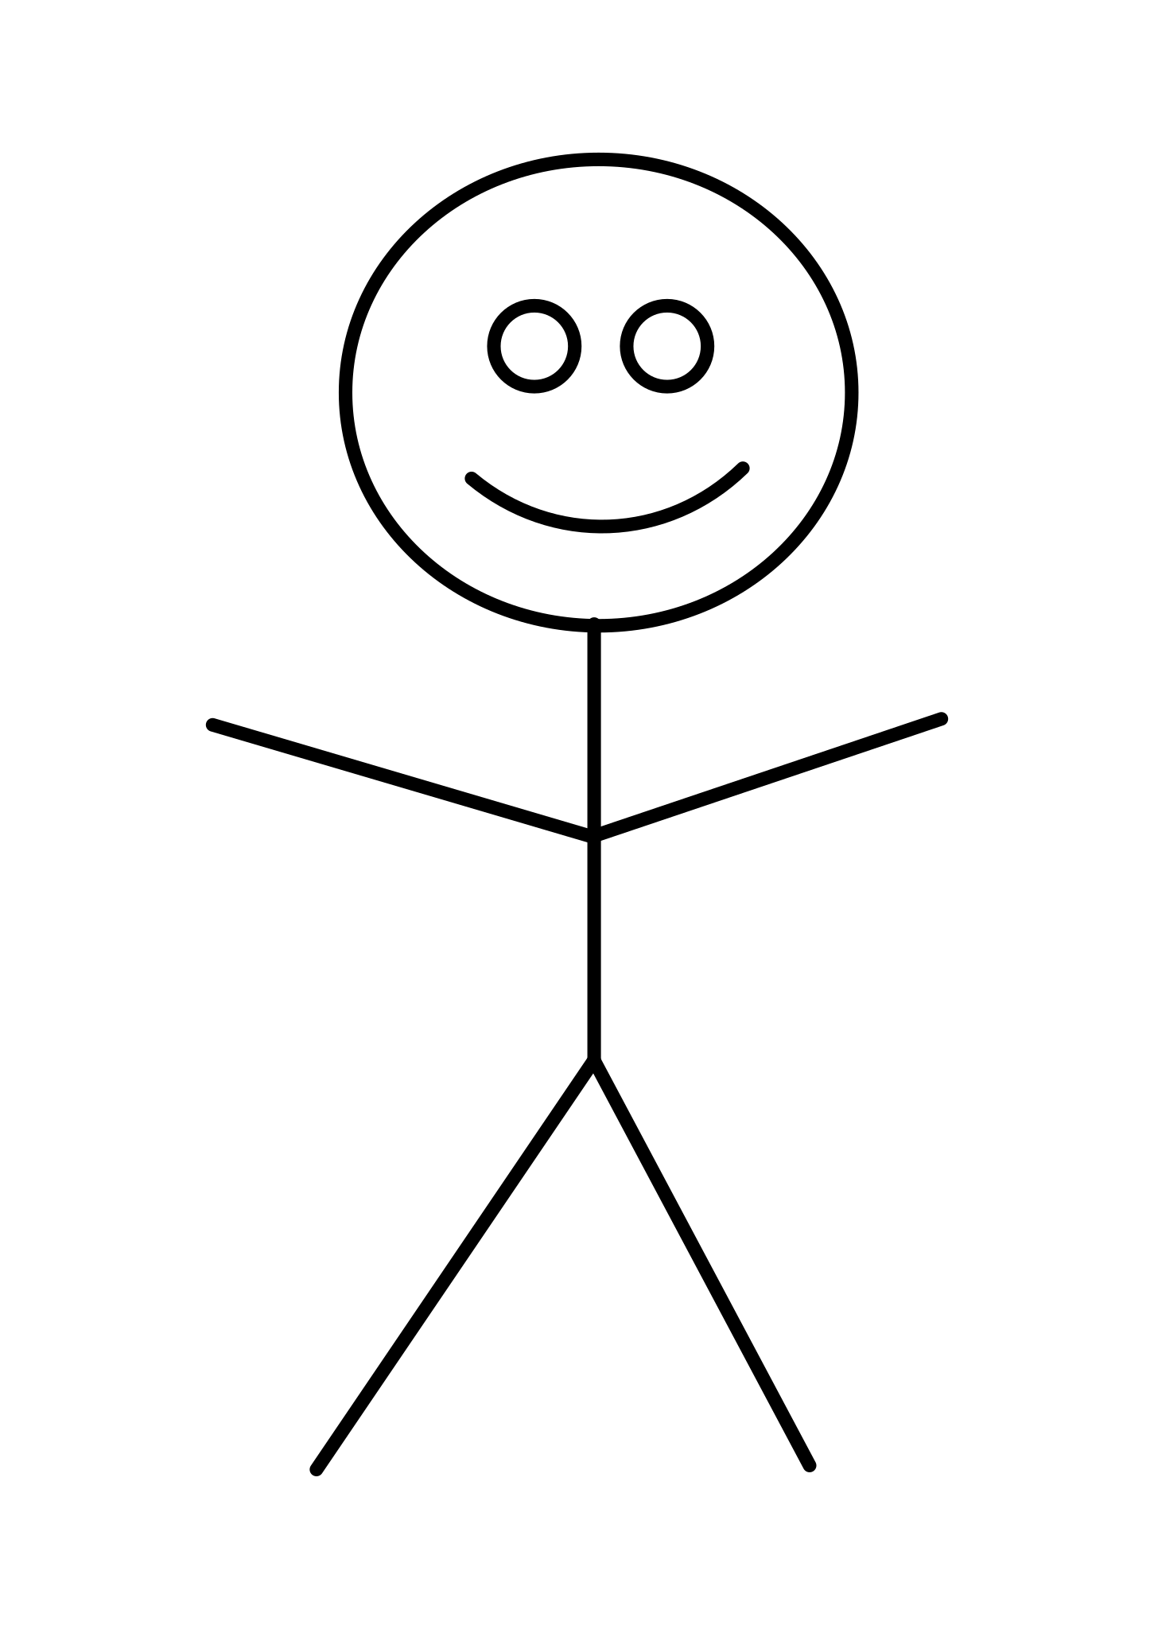
1.1 Summarize Account
Use Case Scenario
This Use case begins when an actor is already logged onto the system, and clicks Summarize Account
The user arrives on the summarize account page and data is fetched from the Authentication and User Class to populate the summarize form
The Use Case ends after this.
User
Authentication
All Roles
getSummarydata()
getSummaryData()
Summary Data
Summary Data

Slide 2
1.2 Authenticate Account
Use Case Scenario
This Use case begins when the actor enters the credentials and tries to log in.
System checks if the user credentials are correct or not.
System allows the Actor to log in if credentials are correct or will send a failure message.
The Use Case ends after this.
Authentication
User
All Roles
login()
postUserCredientials()
Authentication success
generateUserData AndToken()
Authentication Failure
loginError()

Slide 3
1.3 Request Customer Support
Use Case Scenario
This Use case begins when an actor is already logged onto the system, and fills in a Request Support form
The user enters all necessary information for a ticket and receives a confirmation number. I new SupportTicket is created.
The Use Case ends after this.
SupportTicket
Advertiser / Business Owner*
createTicket()
sendConfirmationId()
Ticket Error
*Employee roles don’t request customer support

Slide 4
1.4 Create Account
User
Advertiser / Business Owner
Use Case Scenario
This Use case begins when the actor tries to create an Account.
System checks if the Actor already has an account
It will display a failure message in case it gets an error.
The Use Case ends after this.
Register()
statusMessage()
Return Error

Slide 5
1.5 Modify Account
User
Advertiser / Business Owner
Use Case Scenario
This Use case begins when the actor tries to modify an Account.
System checks if the Actor has an account
It will display a failure message in case it gets an error.
The Use Case ends after this.
modifyUser()
statusMessage()
Return Error

Slide 6
1.6 Cancel Account
User
Advertiser / Business Owner
Use Case Scenario
This Use case begins when the actor tries to cancel an Account.
System checks if the Actor has an account
It will display a failure message in case it gets an error.
The Use Case ends after this.
cancelUser()
statusMessage()
Return Error

